Slide 1
Business Risk
Title Slide
[The purpose of this slide deck is to enable business leaders who have recently implemented a new corporate commitment on land rights to communicate the new policy, its rationale, and subsequent implementation steps.
This presentation is intended to serve as a template to support the communication of key principles of your policy and basic land concepts, but will need to be tailored to your company’s unique needs.
Please refer to the presentation slide notes included on each slide.]
Notes:
Presentation Explanation:
Each slide contains speaker’s notes to provide you or your designated presenter with detailed information to accompany each slide. However, you may decide you need to hire a third party land expert to assist in the adaptation and delivery of slides, particularly those with technical information on land.
This presentation is divided into three modules:
Module 1 presents the business case for company commitments to land rights protections. Wherever possible, you should tailor these slides to specify which teams are impacted by land issues and why team members need to care about your new policy. The module provides context on the role of land in emerging markets, introduces business-related risk stemming from land-related issues, provides global and industry context, and introduces your new policy.
Module 2 provides an overview of land rights, common land-related issues in an investment, and best practices pertaining to land issues in an investment. This module contains technical information that may be useful to incorporate in initial training for staff involved in land & commodity acquisition, supply chain management, auditing or assessing supply chain investments, etc.
Module 3 is intended to be adaptable to your company’s journey for you to lay out the next steps for your staff and suppliers to operationalize your new policy. Because every company’s journey is unique, a majority of these slides will need to be adapted.

Slide 2
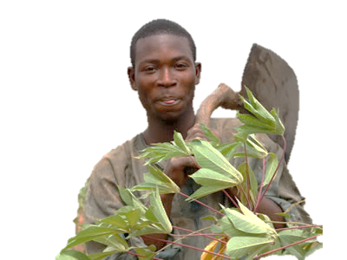
Business Risk
Presentation Overview
Module 1: Why Land Matters
  Land, the Global Context, & [Company]
Module 2: Land Rights Overview
  Land Rights 101
  Investment Principles and Best Practice
Module 3: Company Commitment
  Company Policy & Protocols
  Staff Resources
  Next Steps
Notes:
Slide Explanation:
The purpose of this slide is to introduce the agenda for the presentation. We have included three separate modules organized as follows:
Making the case for your new land rights policy
More detailed overview of land rights, land rights issues, and best practices to achieve responsible investment
Overview of your policy and new protocols. A place for you to provide staff with resources and outline the next steps for the policy implementation

Slide 3
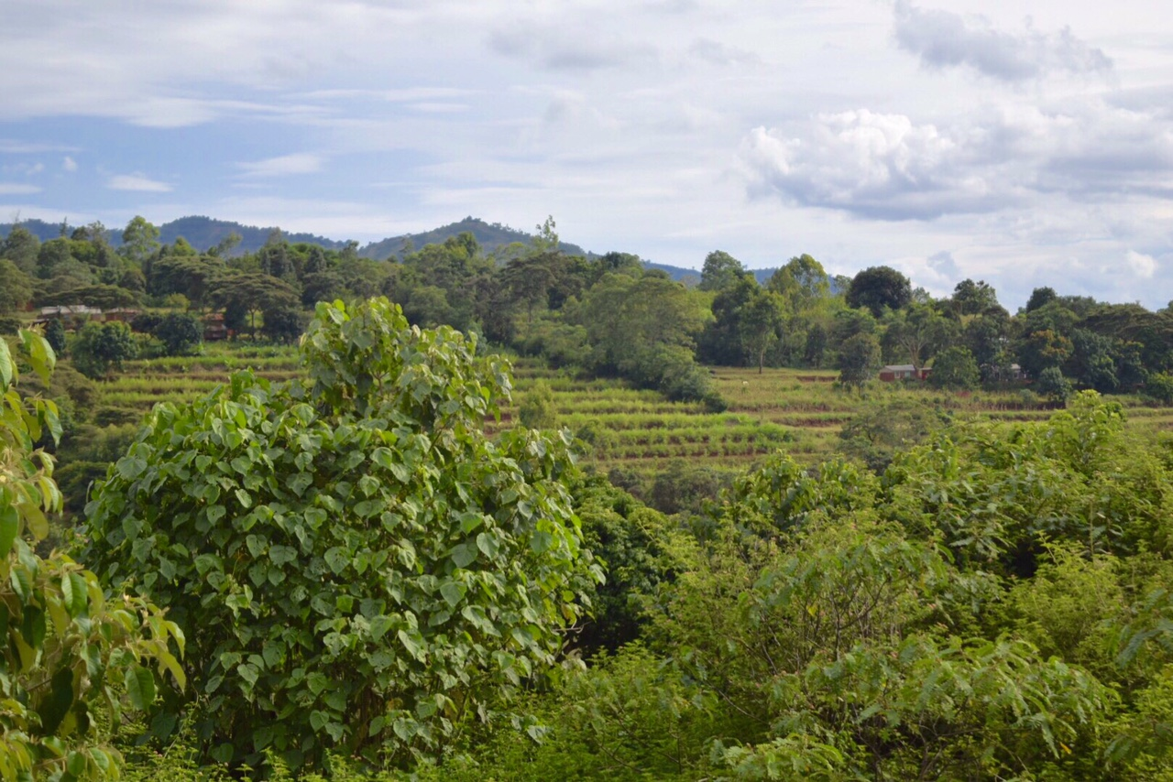
Module 1
Notes:
Photo Credit: Megan Olson

Slide 4




Why Land Matters
Land in Emerging
Markets
  Land is a valuable resource for rural people, the state, and for private investment.
Business Risk
  Land rights is a business risk mitigation and management issue.
International Standards & National Law
  Adherence to best practice, industry standards, and national law
Our Company Commitment
  [Company] commits to [insert key phrase from policy here]
Notes:
Slide Explanation:
The purpose of this slide is to introduce the topic of land rights in the context of your company. The subsequent slides provide opportunity to speak about the topic identified in each box in more detail.
We have included animations on this slide as transitions to introduce each theme; please adjust based on your preference.

Slide 5
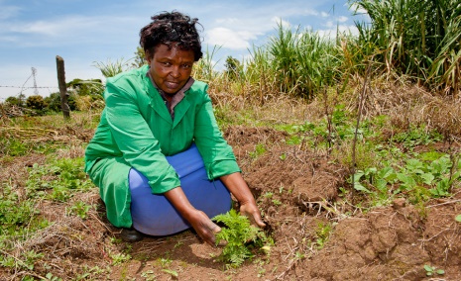
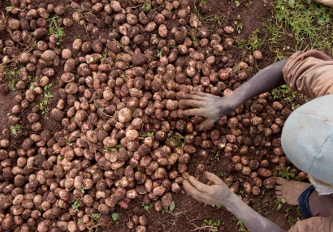
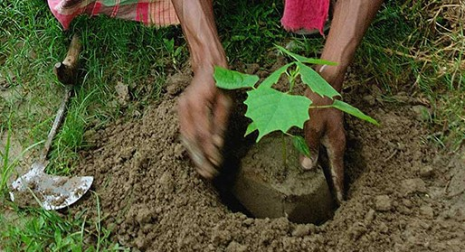
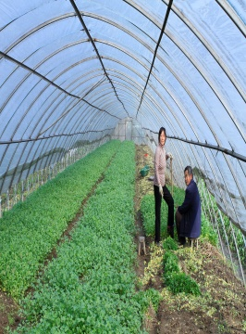
Significance of Land in Emerging Markets
Land
Livelihoods, Identity, & Access
Investment Opportunity
Climate Change Mitigation
State Resources
Stronger rights to land have the power to reduce poverty and conflict, increase economic activity, empower women, strengthen food security, and improve environmental stewardship.
Notes:
Suggested Speaker’s Notes:
Land is a significant asset for rural people, the state, and for private investment. Stronger rights to land have the power to reduce poverty and conflict, increase economic activity, empower women, strengthen food security, and improve environmental stewardship – for an individual, a family, a community, and an entire country.
Land provides rural communities and individual men and women with:
Food production and security/safety net
Income and access to credit
Power, voice, and status
Identity
Access to government services
Land is an important resource in the context of biodiversity conservation
Secure property and resource rights underpin sustainable and climate-resilient natural resource management.
Land tenure security may aid in the uptake and success of climate change programming. For example, farmers with more secure land rights are more likely to plant trees, prevent soil erosion, and slow deforestation rates
Land is a state resource
In emerging markets where a significant portion of the GDP is derived from agriculture, land serves as an important national resource to achieve country development goals and economic growth.
Land is an important national resource to source natural resources (e.g. agriculture, timber, minerals and oils), to house infrastructure works and government institutions, and for wildlife protected areas (e.g. national parks and animal sanctuaries).
Land provides investment opportunities
In the past decade, there has been an increase in the demand for agricultural land. Private investors can purchase, lease, or access land through suppliers to source commodities, invest in infrastructure projects (such as clean energy projects or factories/plants, etc.)
[Consider referencing your company’s unique land holdings either directly or via suppliers and the role this plays in your business]
Slide Explanation:
We have included animations on this slide as transitions to introduce each theme; please adjust based on your preference.
Image Credits: Deborah Espinosa, Landesa

Slide 6
Significance of Land for [Company Name]
Notes:
Slide Explanation:
The purpose of this slide is to provide highlights of the role of land specific to your company, if desired.
We have included a sample template to highlight geographies of your current land investment. This template is copyrighted by Presentation Magazine; other templates available for free business and personal presentation use are available at www.presentationmagazine.com

Slide 7
Business Risk
Land Issues Can:
  Delay projects
  Add costs
  Damage brand reputation
  Compromise project financing
  Risk investment viability
“Companies ignoring established land rights can incur financial damages ranging from operating costs increased by as much as 29 times to outright abandonment of operations.”
Notes:
Suggested Speaker’s Notes:
Land-Related Investment Risk:
An understanding of land tenure issues can be the difference between a failed investment and successful one.
Failure to address land tenure issues in our investments can lead to social unrest. Social unrest is not good for our business. Sufficient social unrest can lead to:
Disruption in construction or production – loss of cash flow and return.
Harassment of employees.
Loss of insurance coverage or credit rating risk.
Potential abandonment of assets.
Government review and/or change of perspective.
Poor public relations.
[This is a good place to outline business risks specific to your company. Point to specific examples of operations being disrupted (e.g. crop destruction, encroachment, community protests, inability to access certain areas of an operation].
Quote Source: Lou Munden, Chief Executive of The Munden Project, summarizing findings from the Munden Project’s Report The Financial Risks of Insecure Land Tenure: An Investment View in press release in February 2013.

Slide 8
Business Risk
Sources of Land Issues
Investment-Related Land Issues
  Gaps in National Legislation
Purchase & Lease (incl. legacy issues)
  Historic Inequity
Supply Chain & Procurement
  Informal Rights
Faulty Legal License
  Corruption
Coordination Gaps
Lack of Social License
Notes:
Slide Explanation:
This slide is not exhaustive, but rather is intended to provide an overview of underlying challenges related to land governance that can result in investment risk. More information on these issues is covered in-depth in later slides of this presentation
Suggested Speaker’s Notes:
Types of Land-Related Issues:
Many emerging economies lack governance frameworks embodying land governance best practices. If they are in place, the capacity of the government and landholding communities is often insufficient to implement them.
In an operational land governance framework, for example, no sale, lease, or change in the use of a land asset occurs without notice, consultation, negotiation, and consent. Equitable and beneficial deals are the rule, and if there is a dispute or breach of an agreement, judicial and administrative remedies are available and accessible.
Example land governance challenges could include:
Inadequate national land policies, laws, and regulations to cover equitable purchase and lease
Capacity challenges that limit governance framework implementation
History of problematic expropriation
Prevalence of informal rights - Insufficient legal and regulatory safeguards for protecting customary rights holders, particularly women and vulnerable groups. Lack of standardization and documentation of customary rules from community to community.
Corruption and self-dealing
Coordination and information gaps
These governance gaps can result in a variety of land issues for an investment:
Land issues can occur during the course of a land acquisition and can even be inherited from predecessor’s past actions when acquiring existing landholdings. Any inherited land issues are commonly referred to as “legacy issues”
Land issues can impact a business without direct land holdings but that procures from suppliers that hold land
Land issues can arise from actions contrary to national legislation. However, actions can be legal per national standards but not in keeping with international best practices.
Frequent missteps in an investment include:
Failure to identify all of the land users, include those of women and those who hold informal rights
Lack of consultation with and/or consent by community members, especially women
Inadequate compensation and/or distribution of benefits
Poorly assessed/mitigated environmental and social impacts
Poor investment monitoring, communication, and continued engagement.
These missteps often result in a failure to obtain and/or maintain social license. Social license to operate can be defined as the measure of trust and confidence society has in a business to behave in a legitimate, transparent, accountable, and socially acceptable way.

Slide 9
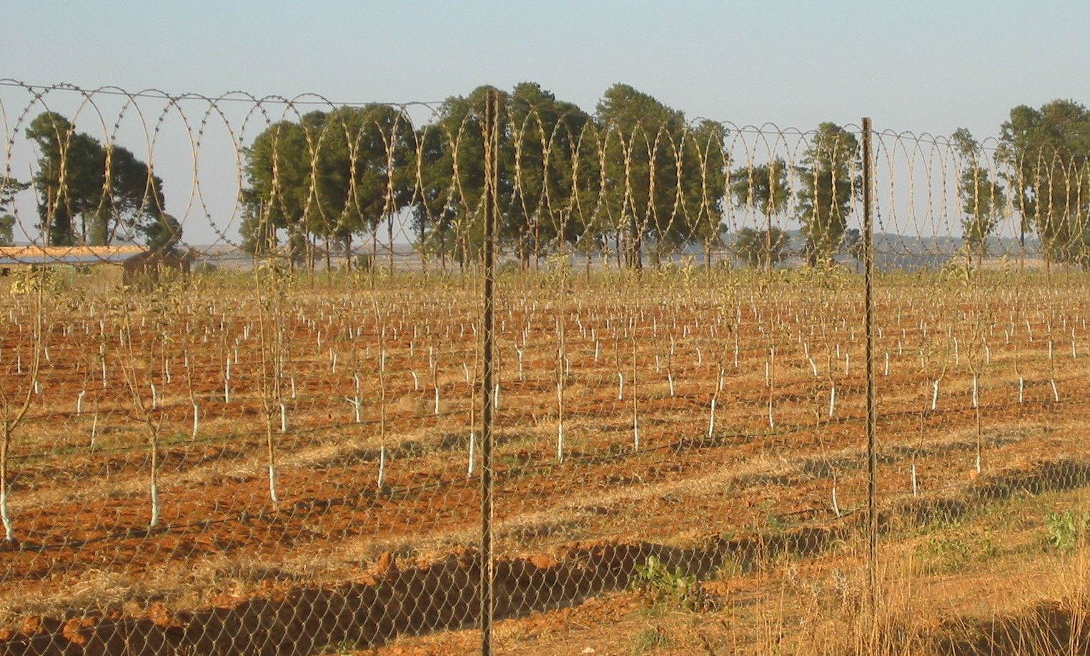
Business Risk
[insert quote from case relevant to your company]
Notes:
Slide Explanation:
Understanding and addressing land issues makes good business sense. The purpose of this slide is to highlight case examples of business risk. Tailor cases appropriately to the company’s industry and include relevant examples from company’s experience as appropriate.
Some examples by region include:
Asia
In an oil palm plantation in Indonesia, an Indonesian company obtained land from the government that was claimed by indigenous communities. The company eventually sold that land to a British government investor, which came under harsh criticism from the British public and the NGO community. Years of public pressure, combined with the investor’s failure to implement a cooperative farming scheme, forced it to abandon the project.
To protect its coal mining concession in Indonesia, a Korean company enlisted the help of a local non-state militia to suppress protests from villagers claiming customary rights over the land. The villagers responded first by obtaining a court ruling in their favor, and then enlisted their own local militia to establish a blockade, barring the company from accessing the land. See Rosanne Rutton, et al., Smallholder Bargaining Power in Large–Scale Land Deals: A Relational Perspective (2017).
Africa
A 2014 analysis found that “a major, world-class mining project with capital expenditure of between US$3-5 billion will suffer roughly US$20 million per week of delayed production in Net Present Value terms due to land tenure issues.
In a sugar cane operation in southeast Africa, community members encroached on land legally leased by the operator. Community members claimed the former operator (who granted the lease rights to the current operator) did not compensate all land rights holders and users and that the compensation was inadequate. Claimants occupied the disputed land, preventing the operator from accessing the land. A court case resulted in a ruling in the operator’s favor, which was rejected by claimants.
Latin America
An investor abandoned a hydro electric plant in Chile due to failure to address land rights of indigenous peoples. Losses exceeded USD75M and scrapped plans to invest more than USD1B in the country. See The Financial Risks of Insecure Land Tenure: An Investment View. 2012. The Munden Project. pg. 25-27.
Photo Credit: David Bledsoe

Slide 10
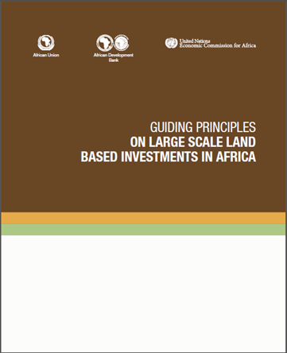
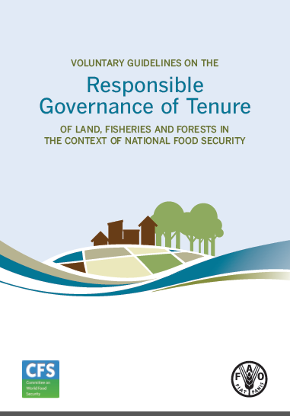

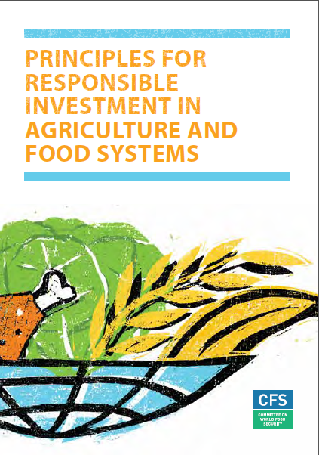
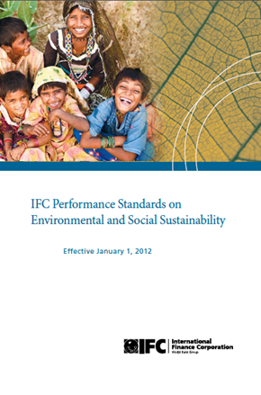


International Standards & National Law
It is possible for something to be legal under domestic laws and policies, but unjust under international best practices.
Notes:
Suggested Speaker’s Notes:
Our operations need to comply with national law. In some instances, there may be gaps in national laws. This means that it is possible for something to be legal under domestic laws and policies, but unjust under international best practices. We must therefore look beyond national legal frameworks to international standards, as well as established industry standards.
Respect for the land rights of individuals and communities is considered international best practice and is an established industry standard for a growing number of companies

Slide 11
International Standards & National Law
Standards
Voluntary Guidelines on the Responsible Governance of Tenure
Principles on Responsible Agricultural Investment
Guidelines
New Alliance Analytical Framework
OECD-FAO Guidance
IFC Performance Standards
Interlaken Group Guidance
Equator Principles III
UN Guiding Principles on Business & Human Rights
UN Global Compact
CFS Principles for Responsible Investment in Agricultural & Food Systems
AU Guiding Principles on Large-Scale Land Based Investments in Africa
Commodities standards & certifications
USAID Operational Guidelines
Landesa RIPL Guidebooks
FAO Technical Guides on VGGT Implementation
Notes:
Suggested Speaker’s Notes:
Key elements of international best practice affirmed in standards such as those shown here are:
Recognize and respect tenure rights
Assess and mitigate impacts
Ensure adequate participation, consultation, & negotiation that reaches women and vulnerable groups
Provide full and fair compensation for all foregone land uses and rights
Monitor & enforce agreements and establish grievance mechanisms
Address food security and gender issues
Module 2 of this presentation will review in more detail what these elements mean and how we can implement them in our operations.

Slide 12




International Standards & National Law
“Agricultural & forestry developments and activities on local peoples’ land are subject to the free, prior and informed consent of the affected local communities”
“The Coca-Cola Company believes that land grabbing is unacceptable “
“The rights and title to property and land of the individual, indigenous people and local communities are respected”
“[PepsiCo] has a zero tolerance for illegal activities in our supply chain and land displacements of any legitimate land tenure holders”.
Notes:
Slide Explanation:
The purpose of this slide is to illustrate that the respect for the land rights of individuals and communities is an established industry standard for a growing number of companies.
[If your company has made a land commitment, add it here.]
Sources:
The Coca-Cola Company Commitment to Land Rights and Sugar. Page 1. Available at: http://assets.coca-colacompany.com/6b/65/7f0d386040fcb4872fa136f05c5c/proposal-to-oxfam-on-land-tenure-and-sugar.pdf
Unilever Responsible Sourcing Policy. Page 10. Available at: https://www.unilever.com/Images/slp-unilever-responsible-sourcing-policy-2014_tcm244-409819_en.pdf
PepsiCo Land Policy. Page 1. Available at: http://www.pepsico.com/Assets/Download/PepsiCo_Land_Policy.pdf
Nestlé Responsible Sourcing Guideline . Page 5. Available at: http://www.nestle.com/asset-library/documents/library/documents/corporate_social_responsibility/nestle-responsible-sourcing-guidelines.pdf

Slide 13
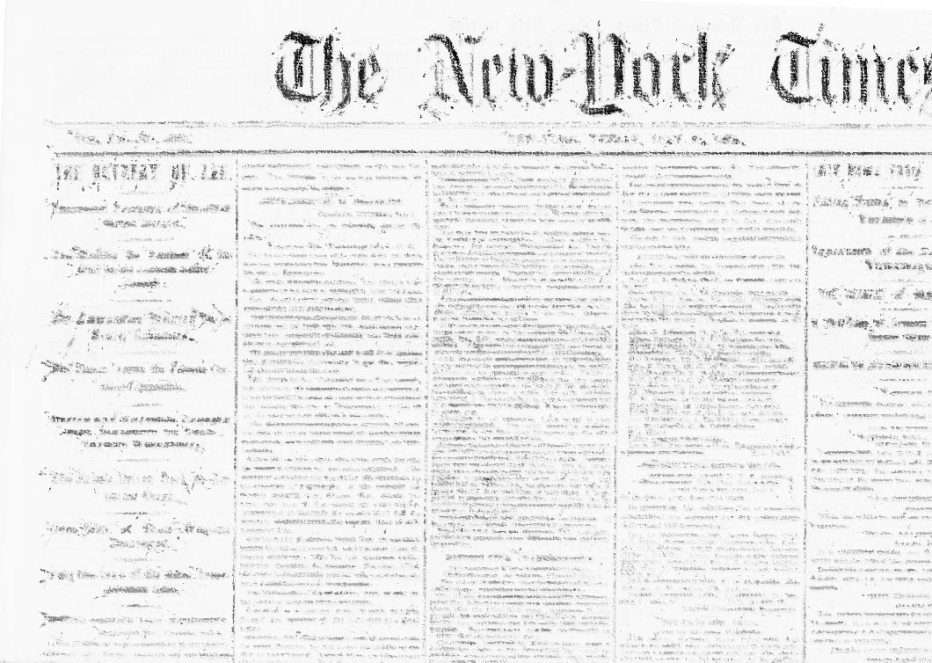
International Standards & National Law
“The
Global Farmland
“Nothing Sweet
About It:
Grab”
How
Sugar Fuels Land Grabs”
“Palm Oil Land Grab
Exposes Need
for human rights treaty”
Notes:
Suggested Speaker’s Notes:
It is worth noting that there are multiple pressure points pushing adoption of socially responsible policies and practices. For instance, media, civil society, and consumers are pushing for adoption of international best practices.
Campaigns like Oxfam’s Behind the Brands and associated consumer boycotts prove that consumers have an increasing desire for sustainably and responsibly sourced products.

Slide 14

Our Company Commitment
“ [Company commits to zero tolerance for land grabbing…]”
Notes:
Slide Explanation:
A slide to highlight an important message from your new policy

Slide 15
Our Company Commitment
How We Got Here
Key Principles
  [XXX]
e.g. Zero Tolerance for Land Grabs
  [XXX]
e.g. Sustainable Sourcing
  [XXX]
e.g. Principles of FPIC
  [XXX]
[XXX]
e.g. Respect Women’s Rights
Notes:
Slide Explanation:
A placeholder for you to adapt to highlight the steps you took to arrive at your new policy and some of the policy’s key elements

Slide 16
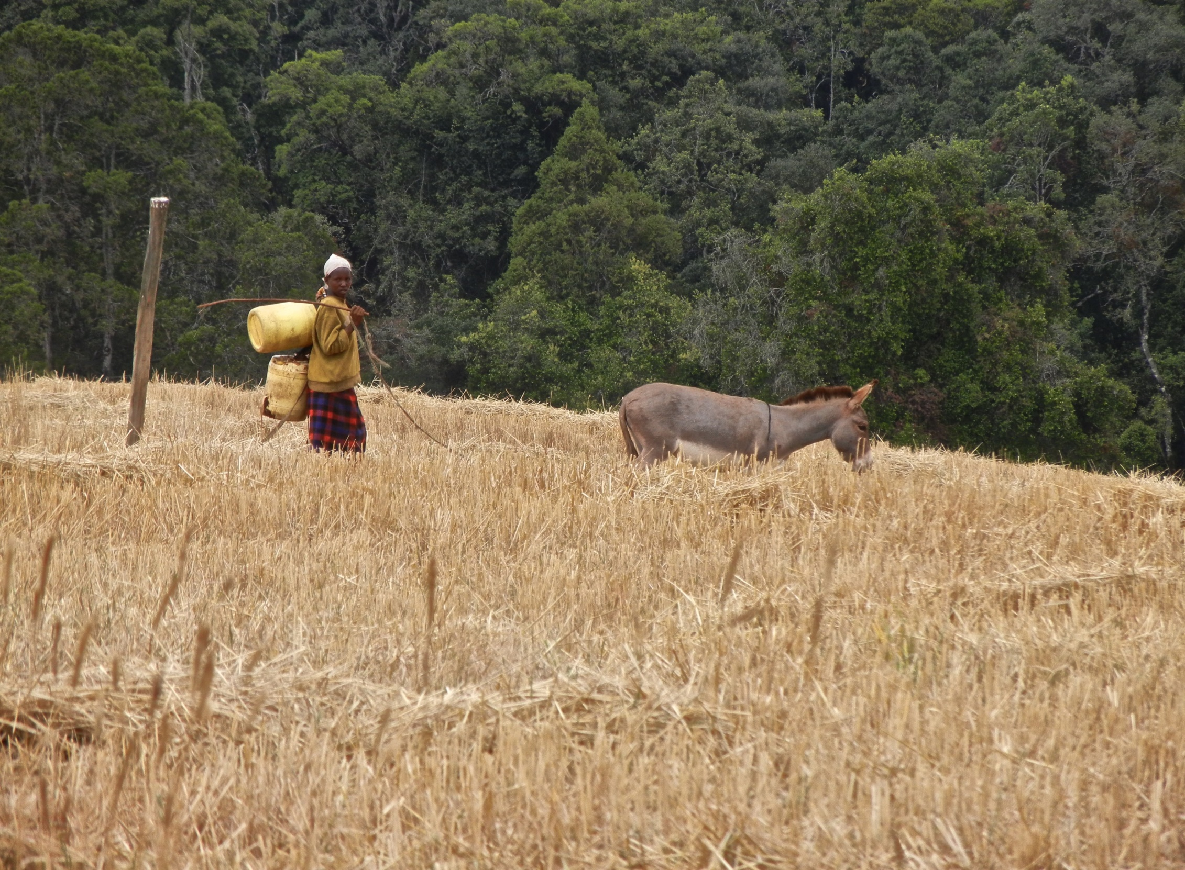
Module 2
Notes:
Photo credit: Jennifer Duncan

Slide 17


Land and Responsible Investment
Defining
Land Rights
  Land Rights 101
Land Issues in
Investments
  What is a responsible investment and what are the key issues that impede its attainment?
Responsible
Investment
Principles
  Understanding Social License, FPIC, and Gender
Steps to
Responsible
Investment
  5 important best practices to achieving socially responsible investments
Notes:
Suggested Speaker’s Notes:
The purpose of this slide is to introduce the topic of land and responsible investment. The subsequent slides provide opportunity to speak about the topic identified in each box in more detail.
We have included animations on this slide as transitions to introduce each theme; please adjust based on your preference.

Slide 18
Defining Land Rights
What is Tenure?
How people gain access to natural resources
Tenure
Governance of Tenure?
How society manages access to and control over natural resources
Notes:
Suggested Speaker’s Notes:
What is Tenure?:
Tenure refers to how people gain access to natural resources, such as land, fisheries and forests.
In regards to land, it concerns the use, development, transfer, and succession of rights to land.
This can be through formal rights recognized in legal systems or can arise from custom, depending on the local context. While formal systems are based on statutory law, in customary systems, the rules, practices, and rights associated with land governance are not necessarily documented but are derived from and sustained by the customary norms and practices specific to each community.
What is Governance of Tenure?
Governance of tenure refers to how a society manages access to and control over natural resources. It refers to both the organizations (e.g. government institutions) and the rules and process. These can be formal or informal (customary institutions and practices).
A majority of emerging market countries have pluralistic systems that contain both formal and customary tenure governance. Some of these countries legally recognize both systems as equal guarantees of tenure security, while others do not.
Slide Explanation:
We have included animations on this slide as transitions to introduce each theme; please adjust based on your preference.
Sources: Definitions based on those of the United Nation’s Food and Agriculture Organization (FAO). Refer to FAO’s Tenure Webpage available at http://www.fao.org/nr/tenure/en/ for additional definitions and helpful explanations.

Slide 19
Defining Land Rights
Spectrum of Tenure Rights?
Ownership and Use Rights
Community and Individual
Formal and Informal
Documented or undocumented
Tenure
What is Tenure Security?
Degree of confidence users will not be arbitrarily deprived of the rights they hold over natural resource and associated benefits
Notes:
Suggested Speaker’s Notes:
What Kind of Tenure Rights Are There?
Generally, these rights can be to occupy or access, to “own” or to “use”
These rights can be communal or individual. To say that rights can be communal means that a community holds the rights to manage and control use of the land. Usually the community either owns the land or the state owns the land and devolves land management to the communities.
They can be to own outright or to lease – for an indefinite period or limited period
Rights can be documented (registered) or undocumented.
They can be to use a resource. In the case of land, such as to have access to collect resources such as food, water, or wood or to graze animals.
What is Tenure Security?
In regards to land, land tenure security exists when an individual or group is confident they have rights to a piece of land on a long-term basis, protected from dispossession by outside sources, and with the ability to reap the benefits of labor and capital invested in the land, whether through direct use or upon transfer to another holder.
An man or woman’s land rights are more secure when they are:
More Legitimate – legally and socially recognized
Less Vulnerable – withstand changes in family relations and communities
More Enforceable
Granted for a longer period
Exercised with more independence
Slide Explanation:
We have included animations on this slide as transitions to introduce each theme; please adjust based on your preference.
Sources: Definitions based on those of the United Nation’s Food and Agriculture Organization (FAO). Refer to FAO’s Tenure Webpage at http://www.fao.org/nr/tenure/en/ for additional definitions and helpful explanations.

Slide 20
Land Issues in Investments
What is a land grab?
Anytime people are displaced?
A lawful state taking?
An unequal bargain to purchase or lease?
When land is turned to cash farming?
When women (but not men) lose access?
When land is encroached upon?
When land is individualized?
When a tenant is evicted?
When water is unavailable?
Notes:
Suggested Speaker’s Notes:
There are many definitions and different understandings of what constitutes a land grab:
A land grab is any land deal that happens without the free, prior and informed consent of communities. See Oxfam, “The Truth About Land Grabs,” https://www.oxfamamerica.org/take-action/campaign/food-farming-and-hunger/land-grabs/ (last accessed June 1, 2018).
A land acquisition on the part of government, business, or both together that failed to respect land rights and uses and that displaced individuals or communities is an evident example of a land grab.
But many other actions can also constitute a land grab, have the impact of being a land grab, or be perceived as a land grab, in that they divest communities and individuals of their land uses without their consent.

Slide 21
Land Issues in Investments
When is a land investment responsible?
When land is: leased, purchased, or otherwise obtained
so that legitimate land rights and interests of all
women and men
who own, occupy, cultivate, or otherwise use the land
are accurately identified, respected, and compensated for over the life of the investment.
Notes:
Suggested Speaker’s Notes:
A responsible investment is more than following best practices in a new direct land acquisition or direct company holdings. Best practices should be adhered to in supply chain procurement.
For an investment to be responsible, specific efforts must be taken to respect the land rights, interests, and uses of ALL stakeholders. It is particularly important to support the participation of vulnerable groups, such as women, youth, elderly, ethnic or religious minorities, indigenous people, and pastoralists. In order to identify and respect rights, it is critical to consult with ALL stakeholders.
For an investment to be responsible, you must identify the rights and uses of the land beyond what’s formally documented. Frequently in emerging markets, land rights are overlapping or undocumented. Accurate identification of rights and uses is essential for ensuring compensation for livelihoods losses.
For an investment to be responsible, best practices must be continued over the life of the investment (post-obtaining land). Community engagement must be ongoing; remedy accessible and effective; and monitoring and evaluation continued.

Slide 22
Land Issues in Investments
Governance Gaps
  Gaps in National Legislation
  Historic Inequity
  Corruption
Coordination & Capacity Gaps
  Informal Rights
Investment Complexity
  Supply Chain Diversity
  Corporate Buyer Distance
  High Agency Costs
Notes:
Suggested Speaker’s Notes:
As mentioned in Module 1, many emerging economies lack governance frameworks embodying land governance best practices. If they are in place, the capacity of the government and landholding communities is often insufficient to implement them.
Example land governance challenges could include:
Inadequate national land policies, laws, and regulations
Capacity challenges that limit governance framework implementation
Coordination and information gaps between government units that result in difficulties and inefficiencies in implementing laws.
History of problematic expropriation
Corruption and self-dealing
Prevalence of informal rights - Insufficient legal and regulatory safeguards for protecting customary rights holders, particularly women and vulnerable groups. Pluralistic nature of land rights in many countries.
Supply Chains: Depending on the type of investment model considered, the situation can be complicated by supply chain diversity and complexity. Smallholder growers and communities are sometimes many links away from corporate buyers, who may have imperfect information and need to rely on national and regional suppliers. There are agency costs involved to influence and monitor supplier behavior.

Slide 23
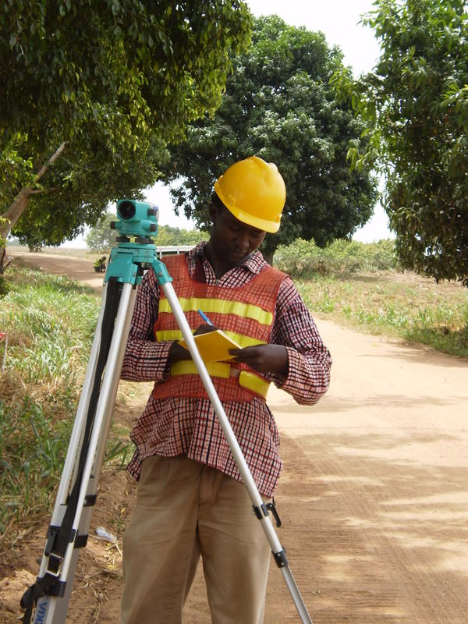
Land Issues in Investments
1. Unclear land rights
  Failure to identify and map accurately all land rights and uses
  Failure to consult, engage, and compensate all affected parties
  Poor assessment of social impacts
Notes:
Suggested Speaker’s Notes:
In such an environment, there are a number of land issues that could complicate investments. One critical challenge is a lack of unclear land rights.
Unclear land rights as an investment barrier:
In order to proceed with acquisition or lease of land, one must first know who has existing rights to that land. Unfortunately, it is rarely as easy as relying on the government land records.
Land records often do not reflect ground-level realities as understood by those possessing or using the land. Land rights are likely to be unclear and poorly documented. They may be disputed or overlapping. Women’s land uses may be unrecognized and remain unidentified because they are often secondary to men’s rights and uses.
When there are unclear land rights, a business may:
Fail to identify and map accurately all land rights and uses.
This impacts a business’ ability to consult and compensate all parties
This can also impact a business’ ability to accurately assess and therefore mitigate all environmental and social impacts of the proposed investment.
These can lead to ongoing problems throughout an investment of encroachment, social unrest, boundary conflicts, compensation disputes.
Photo Credit to Landesa

Slide 24
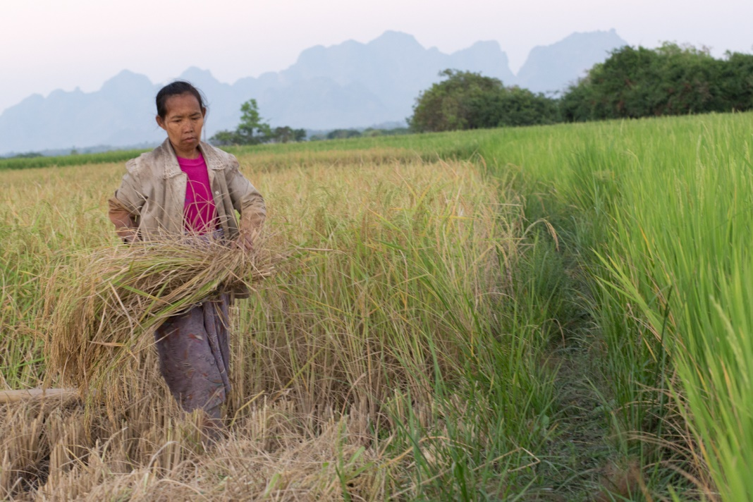
Land Issues in Investments
2. Legacy Land Issues
  Inherited land issues, not direct result of company’s actions
  A prior company or the government failed to follow best practices
  Result in operational & reputational risks
Notes:
Suggested Speaker’s Notes:
Land issues can also be inherited from predecessor’s past actions when acquiring existing landholdings. Any inherited land issues are commonly referred to as “legacy issues.” Legacy issues are likely when a country has a history of problematic expropriation and corruption.
Occur when a prior owner or the government acquired land in a way that did not follow best practices (e.g. failed to map all land uses, failed to consult all land users, did not properly assess all potential impacts, did not have a proceed for resolving grievances, did not follow through on promises, such as compensation).
A company may need to mitigate ongoing or future risks and inequities even when the issues may not have been the direct result of a company’s actions. A company is still a beneficiary of those prior unjust or problematic acts.
When pre-existing claims of local land users are left unaddressed, disagreements and distrust can create financial, liability, and reputational risks even when a company is not legally at fault. Unresolved disputes can result in increased operational expenditures due to protest, physical damage (such as through arson), and project delays.
Inherited land issues can compromise a company’s reputation just as much as a company’s own direct actions.
Photo Credit to Landesa

Slide 25
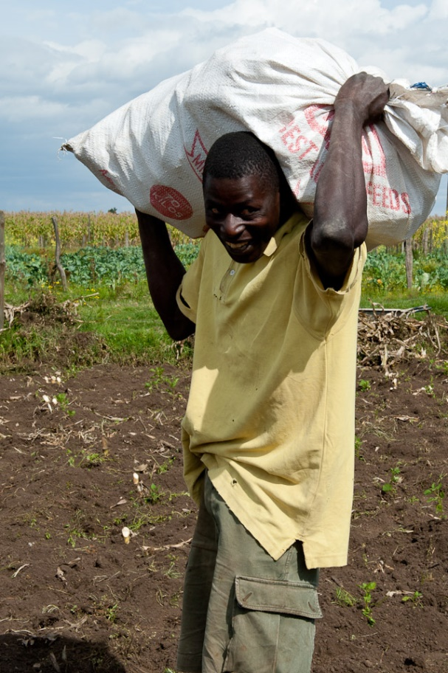
Land Issues in Investments
3. Access to Remedy
  Lack of efficient/ effective state-based mechanisms
  Ineffective company-based grievance mechanisms
  Companies lack channels to identify & respond to ongoing issues
Notes:
Suggested Speaker’s Notes:
Where governance gaps may be significant, there are likely to be gaps in state-based judicial grievance mechanisms. Although a formal dispute resolution processes may be in place, it may be impractical or inaccessible for most citizens, particularly those in poor, rural areas. Engaging in the formal court system can be expensive, time-consuming, or inefficient, so it can be difficult for communities and individuals (both women and men) to raise concerns or complaints related to an investment project.
Grievance channels are important to support social acceptance of an investment and to provide companies with information. They can be a beneficial tool for communities to raise concerns and identify risks associated with the project through an organized and productive channel, but also for the company to identify problems that need to be addressed or policies that need to be changed for the long term viability of the investment.
In situations with gaps in state-based dispute resolution channels, effective non-judicial company-based grievance mechanisms are critical to ensure access to remedy for all parties impacted by the investment and open channels of communication between a company and impacted communities. They can support a learning culture through which we can learn and improve from the types and prevalence of disputes
Photo Credit to Landesa

Slide 26

Responsible Investment Principles:
FPIC
Leaders do not always represent the interests of all land rights holders.
Informed consent should be obtained from all land rights holders and users -- both women and men – or their chosen representatives.
Notes:
Suggested Speaker’s Notes:
Why isn’t it enough for companies seeking to conduct responsible land transactions to work with community leaders?
Because different individuals and types of community members have differing access, participation, and roles in land matters.
Therefore efforts to engage all rights holders must go beyond government officials and community leaders. It is important to note that communities retain the right to self-determine how they will give consent, whether it be through elected representatives, community-wide vote, or some other decision-making process.
The concept of Free, Prior, Informed, Consent or FPIC is a legal principle originating from the United Nations Declaration of Rights of Indigenous Peoples recognizing the right of all land users to say “yes” or “no” to proposed changes in their land use. Universally, this is understood to be a legal principle of good contracting – the party being asked to enter into the contract has the right to say “no”
Photo Credit: Deborah Espinosa

Slide 27
Responsible Investment Principles:
FPIC
Prior
Free
Informed
Consent
An informed, freely entered into, and fair contract bargaining process will include virtually all of the FPIC components
Defining FPIC
Notes:
Suggested Speaker’s Notes:
FPIC generally refers to the right of land rights holders to make decisions through their own freely chosen representatives (which could involve a variety of institutions or processes) and to give or withhold their consent to any project that may affect the land and resources that they own, occupy or use
Free - implies no coercion, intimidation or manipulation.
Prior - implies consent is sought far enough in advance of any authorization or commencement of activities, and the time requirements of stakeholder’s consultation and processes are respected.
Informed - implies that all information relating to the activity is provided to stakeholders and that the information is objective, accurate and presented in a manner or form that is understandable.
Consent - implies that stakeholders have agreed to the activity that is the subject of the consultation
Before obtaining land or changing its use, receive the FPIC of identified land rights holders and users. FPIC seeks to ensure people are not coerced, forced, intimidated, or pressured to transfer or change the use of their land under unfair or unjust circumstances.
Source: FAO, Free Prior and Informed Consent: An Indigenous Peoples’ Right a Good Practice for Local Communities, 13, available at http://www.fao.org/3/a-i6190e.pdf.

Slide 28


Responsible Investment Principles:
GENDER
Women make up more than half of communities and contribute significantly to subsistence and cash crop cultivation
Yet on average, men control a higher proportion of land than women.
It is essential to identify women’s land uses, compensate for those uses, and include women in consultations.
Notes:
Suggested Speaker’s Notes:
Although women’s land use rights and interests are often secondary or unnoticed, they are central to household livelihoods and are almost certain to be significantly impacted by any effort to obtain land.
Between men and women, both in the household and in the community, men have far more power and voice than women do.
Therefore, specific efforts will need to be taken to ensure women are included in consultations and decision-making.
To cause no harm, the company must identify women’s uses of the land (as separate from men’s uses) and fairly compensate them for the loss of the ability to use the land (separate from men’s compensation).
Photo Credit: Landesa

Slide 29
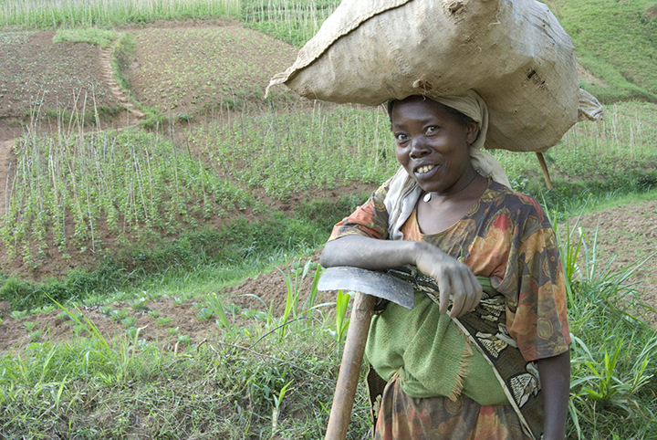
Responsible Investment Principles:
GENDER
Anticipate, identify, and address gender differences
Ensure representation in consultation, compensation, and benefit processes and outcomes
Cause No Harm
Notes:
Suggested Speaker’s Notes:
To be socially responsible: Land-related investments must ensure that women and men are not harmed, are meaningfully consulted and give consent where their rights are affected, are fairly compensated for lost land and resource rights, and benefit equally from the investment.
Importantly, socially responsible investments should not contribute to gender gaps by systematically disenfranchising women or men.
A gender-neutral approach is insufficient - an approach that does not explicitly respect the rights of women and consider women’s needs, insights, and interests will inevitably further the marginalization of women due to prevailing and persistent norms and traditions that discriminate against women.
Active Approach Required- Therefore, in order to meet international best practice, specialized attention is needed to actively anticipate, identify, and address gender differences. This means:
Understanding established gender roles and household dynamics
Supporting gender representation in community management structures, consultations, negotiations, decision-making, and distribution of compensation and benefits.
Photo Credit: Landesa

Slide 30
Responsible Investment Principles:
SOCIAL LICENSE
Social License IS | A measure of society’s confidence and trust that business will behave in a legitimate, transparent, accountable and socially acceptable way.
Social License is NOT | Based on legislative or regulatory compliance
 | A consensus - reflects variety of community perceptions
Notes:
Suggested Speaker’s Notes:
Social license is:
Obtaining and keeping the local communities’ and other stakeholders approval or broad social acceptance of a project. It is increasingly seen as prerequisite to development
Stakeholders can include anyone affected by a project (e.g., those displaced from the land) or anyone who could have an effect on the project (e.g., could organize a protest against the project)
Social license must be distinguished from legal license (which is obtained by abiding by applicable laws and procedures in making a land investment)
It varies from site to site.
Social license is sometimes made evident by its withdrawal rather than by its presence
Obtaining Social License:
Direct, one-on-one consultation and ongoing engagement
Community information sessions, open houses, and workshops
Co-design of projects & benefit sharing arrangements
Community investment programs
Local employment and procurement programs
Disclosure and reporting
Establishment of accessible communications channels

Slide 31
Responsible Investment
Best Practice
How to Acquire & Maintain Social License
Recognize & Respect Tenure Rights
Assess & Mitigate Impacts
Ensure Adequate Participation, Consultation, & Negotiation
Provide Compensation
Monitor & Enforce Agreements
Establish Grievance Mechanisms
1
2
3
4
5
6
Notes:
Slide Explanation:
The purpose of this slide is to introduce 6 key best practices for achieving responsible investment. The subsequent slides provide more detailed information on each topic.

Slide 32
Responsible Investment
Best Practice
Recognize & Respect Tenure Rights
1
Identify & recognize all legitimate rights holders (including customary, secondary, seasonal, & use rights)
Consult experts on national laws & customary practices
Consult government officials & land records
Perform community consultation & participatory mapping
Notes:
Suggested Speaker’s Notes:
1. Identify & recognize all legitimate rights holders (including customary, secondary, seasonal, & use rights)
The processes for identifying land rights holders and users are likely to vary by country. In some countries, identifying land rights holders and users is straightforward, because land rights and uses are formalized. In other countries, however, procedures are typically not clear; this may be due to plural governance systems, prevalence of informal rights, and overlapping rights. In such contexts, community participation in land identification and mapping efforts is critical to ensure accuracy.
Consult with government officials & review land records
Consult with experts on national laws & customary practices. Inquire with local civil society.
Consult with communities & do participatory mappings to identify legitimate rights holders & uses.
Physical inspection/site visits during which the owners, occupants, and other users/claimants are interviewed.
Inquire of adjacent land owners and occupants.
Pay attention to unrecorded users/shadow rights. Consider Casual and secondary uses such as undocumented easements, gathering wood.
Ensure that women’s rights are explicitly included in assessment. Consider time of day of visit, to facilitate women’s involvement.
Identify existing conflicts related to land

Slide 33
Responsible Investment
Best Practice
Assess & Mitigate Impacts
2
Conduct assessments of adverse impacts to rights holders
Involve impacted communities
Identify social impacts
Assess business impacts
Conduct in advance of contract
Share with affected communities
Identify mitigation measures
Notes:
Suggested Speaker’s Notes:
2. Conduct assessments of adverse impacts to rights holders
Before obtaining land or changing its use, carry out environmental, social, human rights, and gender assessments.
Social assessments should:
Identify and anticipate impacts on livelihoods, food security, rights, and indirect social impacts. Should include determination of impact of the investment on women’s access and use of land and resources.
Assess related business impacts to the project
Be carried out in advance of a contract for sale or lease
Be shared with affected communities
Identify mitigating measures
*Note this slide does not address specifics of other critical assessments, such as environmental assessments.

Slide 34
Responsible Investment
Best Practice
Assess & Mitigate Impacts
2
Mitigate Impacts
Alternative investment models
Resolve existing land disputes as necessary
Compensation & Benefit Sharing
Notes:
Suggested Speaker’s Notes:
2. Identify Mitigation Measures
In addition to mitigation measures that look at environmental risks (e.g. water, waste, emissions, soil conservation, energy), identify mitigation for identified social impacts.
If the impact assessment reveals possible or actual negative effects on legitimate tenure rights, attempt to reconfigure the project to minimize breadth and depth of the impact and avoid where possible.
Alternative Investment Models: There are a variety of reconfiguration measures that may be suitable, depending on the circumstances, including:
a. Exploring alternative investment models that do not result in the large-scale transfer of land rights to companies, including partnerships with local land-rights holders and contracts with small-scale producers.
b. Utilizing a different land acquisition structure, such as a lease instead of an outright acquisition.
c. Avoiding the displacement of people by considering feasible alternatives.
d. Reducing the amount of land to be acquired for the project.
e. Allowing community members to continue to use at least a part of the land for subsistence farming.
Resolve Existing Disputes before acquisition:
Resolve existing land disputes before acquiring the land. This may require formalization of the rights of unrecorded land uses.
Compensation & Benefit Sharing:
After evaluating and exhausting options to restructure the investment to reduce impacts, the next step is to move to conversations of compensation and benefit sharing. We will discuss best practices around compensation in more detail a bit later in the presentation.

Slide 35
Responsible Investment
Best Practice
Ensure Adequate Participation,
Consultation, & Negotiation
3
Consultations & Negotiations Are:
Inclusive, Participatory & Meaningful
Held in Advance
Informative & Transparent
Notes:
Suggested Speaker’s Notes:
3. Ensure Adequate Participation, Consultation, & Negotiation
Develop mechanisms for meaningful participation and consultation of all affected rights holders
Participatory & Meaningful: Hold consultations that enable the participation of ALL stakeholders. Stakeholders contribute to shaping the terms of the agreement and give consent – it is not one sided. Special efforts will likely be needed to support the meaningful participation of vulnerable groups, including women. Consultations should be held in accordance with local customs, traditions, and languages. Consultations allow participants to ask questions and share their input, concerns, and expectations; they aren’t one way lines of communication. Equitable contracting requires that communities be brought to an equal footing with investing business enterprises and governments.
Held in Advance: Seek consent in advance of authorization or commencement of investment. This permits stakeholders to provide meaningful input.
Informative & Transparent: Provide all relevant information to stakeholders, both women & men. And safeguard against coercion, intimidation, & manipulation. They should be structured in a way that support men & women stakeholders to understand the terms and processes of agreements A formal agreement plays an important role in memorializing best investment implementation practices and establishing clear rights, responsibilities, and processes to ensure the long-term sustainability and equity of the land transaction. A business must ensure all parties have understanding of legal requirements and contract language; complete and accurate information about the enterprise’s history; the project purpose and geographical scope; the business model and proposed project timeline; the specific land right being sought, including the term of the agreement; compensation and other benefits to land rights holders and their communities; and potential risks, including social, environmental, and financial risks.

Slide 36
Responsible Investment
Best Practice
3
Compensation
4
Be informed by consultation with different stakeholder groups
Include multiple options
Compensation should:
Structured sustainably
Documented
Notes:
Suggested Speaker’s Notes:
4. Compensation: Compensation must reflect the full, multi-generational livelihoods value of the land asset affected by the project/investment. Must determine and incorporate any impacts upon and special needs of women within the community in resettlement and compensation plans
Informed by consultation - Communities and individuals entitled to compensation should be consulted on how they would prefer to be compensated. Ensure you consult with all stakeholders, as different groups may favor different forms of compensation.
Include multiple options - Compensation must reflect the full, multi-generational livelihoods value of the land asset affected by the project/investment. Rights holders and users should be offered multiple compensation options from which to choose. Both monetary and non-monetary compensation options should be presented.
Structured sustainably - Schedule payments to be broken up and made over time, rather than as a one-time lump sum. The overall compensation award will be easier to manage if it takes the form of a medium or long-term source of income, rather than an immediate, large award.
Documented - All agreed upon monetary and non-monetary compensation must be incorporated into the written contract, and associated with timelines and monitoring and evaluation plans.

Slide 37
Responsible Investment
Best Practice
3
Monitor & Enforce Agreements
5
Participatory & Transparent
Enforceable
Monitoring should be:
Developed early
Continuous & Responsive
Notes:
Suggested Speaker’s Notes:
4. Monitor & Enforce Agreements
Monitoring and evaluation (M&E) is essential to earning and maintaining a social license to operate, as M&E can alert the enterprise to the loss of its social license and can provide the information needed to reestablish it.
Participatory: For your plan to be truly effective, involve relevant stakeholders (both women and men) in the development of indicators, benchmarks, assessment processes, and mechanisms for grievance, redress, and learning
Transparent: There must be transparency throughout the process of developing and conducting M&E, as well as disseminating and using the findings to make corrections to design and implementation. The plan – and its updates/findings - should be made available through relevant mediums
Enforceable: Realistic timelines, sufficient capacity (both skills and other resources), and a sustainable plan are key to M&E that can obtain the information needed to both confirm contract compliance and provide input needed to correct any deficiencies in the implementation of the investment.
Developed Early
Continuous & Responsive: Effective M&E focuses upon assessments that provide information needed to make subsequent adjustments and improvements to processes, standards, project design, and project implementation, as necessary. Monitoring should be seen as a source of continuous engagement, learning, and improvement

Slide 38
Responsible Investment
Best Practice
3
Establish Grievance Mechanisms
6
Participatory
Accessible & Transparent
Grievance Mechanisms
Legitimate
Predictable
Equitable
Notes:
Suggested Speaker’s Notes:
6. Establish Grievance Mechanisms
All identified landholders and users must have access to fair grievance mechanisms. Grievance mechanisms can be judicial and non-judicial, as well as state- and non-state-based.
For us, a company-based land-focused grievance mechanism can provide us with:
A tool to engage with communities and strengthen relations
Pro-actively address concerns before they escalate
Efficiently address disputes so they aren’t resolved ad-hoc
Promote a learning culture so we can analyze trends of disputes and take steps to reduce their prevalence.
Grievance Mechanisms should be:
Legitimate: Linked to clear standards to foster trust from all stakeholders.
Participatory: Developed based on consultation with the groups for whom the mechanism is intended. The mechanism is ratified by those parties.
Accessible & Transparent: The mechanism is communicated so all affected stakeholders are aware of the process and adequate measures are provided to provide access for vulnerable groups.
Predictable: Provides a clear and known procedure with time frames and clarity on the types of process and outcome available.
Equitable: Aggrieved parties have reasonable access to information and expertise to engage in a grievance process on fair, informed and respectful terms.
Source: Adapted from UN Guiding Principles – No. 31

Slide 39
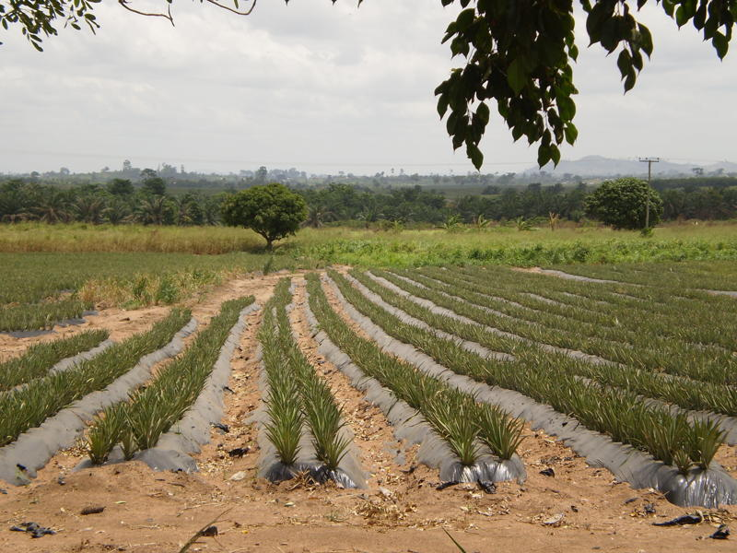
Business Risk
Module 3
Notes:
Photo credit: Landesa

Slide 40
Our Company Commitment
“ [Company commits to zero tolerance for land grabbing…]”
Notes:
Slide Explanation:
A slide to highlight an important statement from your new policy. Provide links or instructions on where staff and suppliers can locate the policy in full length.

Slide 41
Our Company Commitment
Our Policy & Supply Chain Guidance
  Invokes international standards
    [Voluntary Guidelines]
    [FPIC]
    [IFC Performance Standards]
  [Links to existing company policies]
    […]
    […]
    […]
Notes:
Slide Explanation:
A slide to highlight any relevant standards that ground your policy/commitment and contextualize how it relates to existing company policies/commitments.
Sample standards have been included in these template.

Slide 42
Our Company Commitment
Our Policy & Supply Chain Guidance
  [XXX]
e.g. Zero Tolerance for Land Grabs
  [XXX]
e.g. Sustainable Sourcing
  [XXX]
e.g. Principles of FPIC
  [XXX]
[XXX]
e.g. Respect Women’s Rights
Notes:
Slide Explanation:
The purpose of this slide is to introduce your new policy. We have suggested here identifying core principles of your policy. You could link each to international standards or best practices if desired.

Slide 43
Our Company Commitment
Fulfilling Our Commitments
Address Assessment Findings
Map
Commodities
Conduct Assessments
Join Networks
Update Guidelines/ Manuals
Adopt Commitment
Notes:
Slide Explanation:
The purpose of this slide is to introduce to your audience how you plan on operationalizing your commitment. We have suggested here potential steps you may have articulated as part of your policy rollout. Include deadlines for achieving each step if possible.
The subsequent slides serve as placeholders to talk about each step highlighted here in more detail.

Slide 44
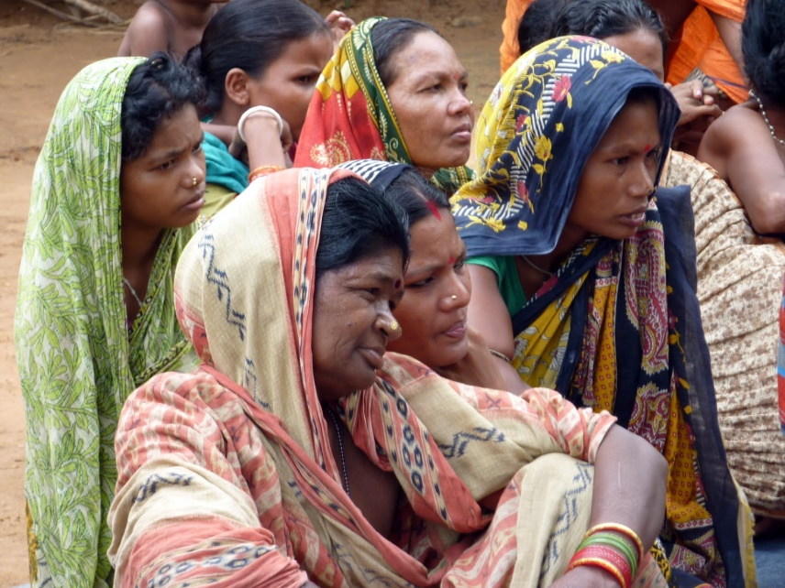
Our Company Commitment
Fulfilling Our Commitments
Updating Guidelines/Supplier Guiding Principles
Joining roundtable/ certification network/ international forums/ industry group
Notes:
Slide Explanation:
The purpose of this slide is to introduce to your audience how you plan on operationalizing your commitment.
Photo Credit: Landesa

Slide 45
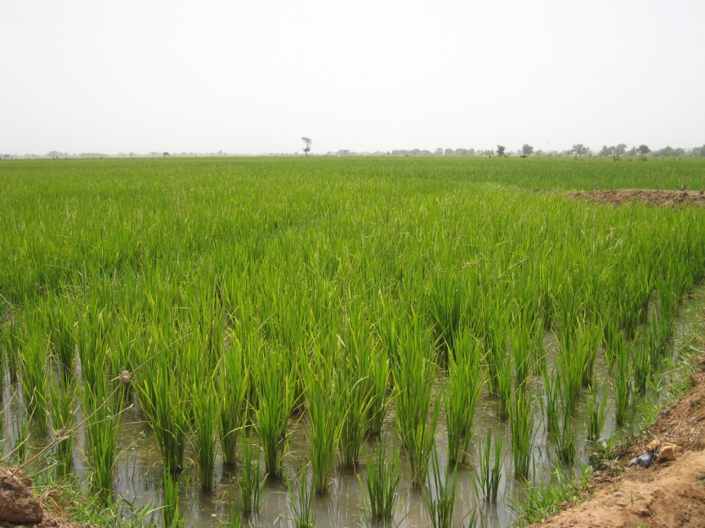
Our Company Commitment
Fulfilling Our Commitments
Social, environmental and human rights assessments of ongoing operations
Developing and maintaining a map of agricultural commodity supply chain
Develop strategy for resolving assessment topics of concern
Notes:
Slide Explanation:
The purpose of this slide is to introduce to your audience how you plan on operationalizing your commitment.
Photo Credit: Landesa

Slide 46
Our Company Commitment
Resources for Staff
FAO Governance of Tenure Technical Guides and E-Learning Modules.
  Technical Guide No. 1 Governing land for women and men
  Technical Guide No. 7 Responsible governance of tenure: a technical guide for investors
Responsible Investments in Property and Land
  Guidebooks, thematic primers, links to external resources
Notes:
Slide Explanation:
The purpose of this slide is to provide resources for your audience.

Slide 47
Our Company Commitment
Resources for Staff
Interlaken Group Corporate-Level Guidance
  Interactive guide on the Voluntary Guidelines
  Operational Guidance
  Legacy Land Issues Operational Guidance
USAID Operational Guidelines for Responsible Land-Based Investment
New Alliance for Food Security and Nutrition’s Analytical Framework for Responsible Land-Based Investments in African Agriculture
Notes:
Slide Explanation:
The purpose of this slide is to provide resources for your audience.

Slide 48

Land issues pose real risks.
We commit to [insert key statements from policy].
Issues can be complex: “legal” doesn’t mean “right.”
Issues can be addressed with best practice steps.
[Insert available operational guidance or available resources for staff/suppliers]
[Include any next steps]
Key Takeaways
Every employee & supplier is responsible for addressing land rights issues in our operations and demonstrating compliance with international standards.
Notes:
Suggested Speaker’s Notes:
Land issues pose real operational and reputational risks.
Our land rights policy commits to [insert key statements from policy]
These issues can be complex with cultural and geographic nuance; the historical situation matters and “legal” doesn’t mean “right.”
Issues can be addressed. Key steps include identifying all land users & potential impacts; communicating, negotiating, & compensating all land users; and establishing ongoing communication & accountability structures.
[Explain next steps for operational guidance and outline available resources for staff/suppliers]

